Slide 1
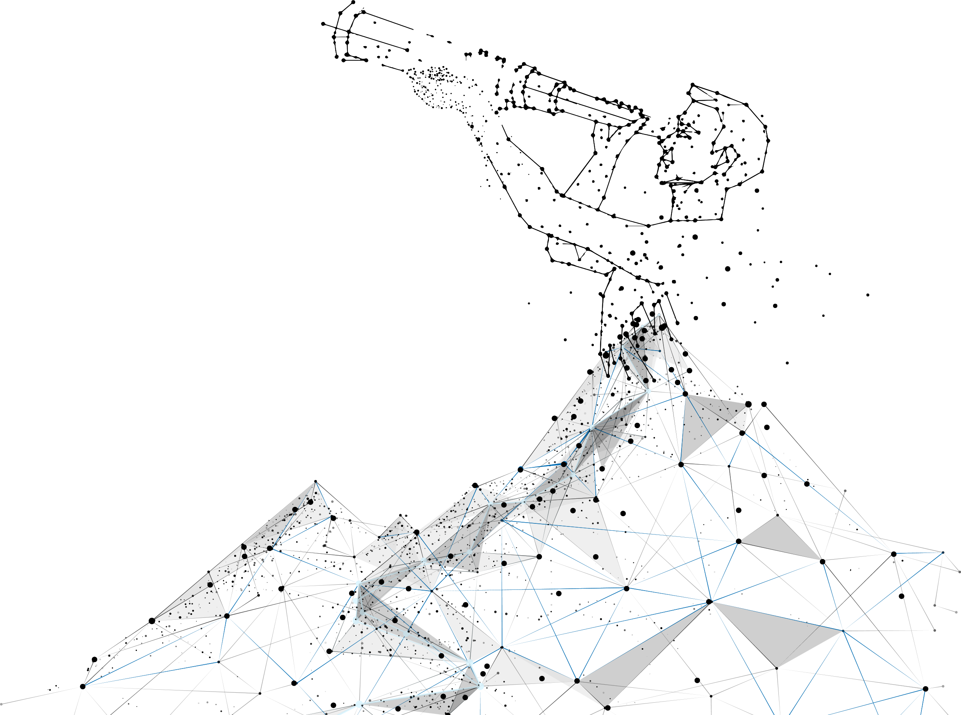
Communication Skills

Slide 2
What are communication skills?
Communication skills are abilities you use when giving and receiving different kinds of information.
Why Communication Skills Matter?
Effective communication fosters better relationships in personal and professional settings.
Clear communication reduces misunderstandings and increases productivity.
Influences leadership success and team collaboration.
Essential for networking and building connections.

Slide 3
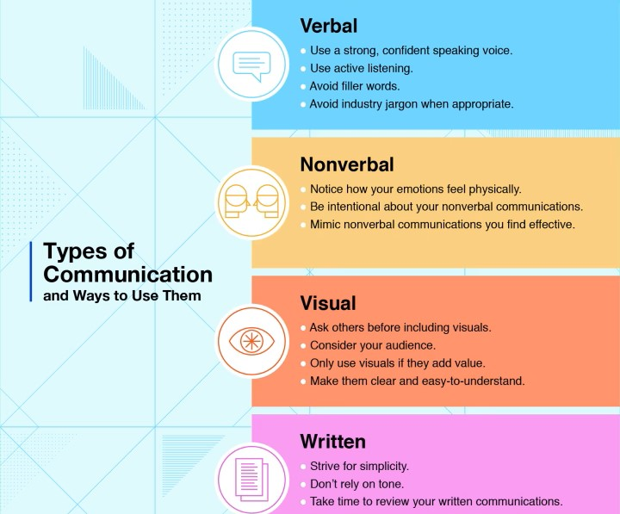
What is Sales Closing?

Slide 4
Most common sales closing techniques

Slide 5
How to Communicate effectively in your workplace
✅ Be clear and concise
Making your message as easy to consume as possible reduces the chance of misunderstandings, speeds up projects and helps others quickly understand your goals. Instead of speaking in long, detailed sentences, practice reducing your message down to its core meaning.
✅ Practice empathy
Understanding your colleague's feelings, ideas and goals can help you when communicating with them. For example, you might need help from other departments to get a project started. If they're not willing to help or have concerns, practicing empathy can help you position your message in a way that addresses their apprehension.

Slide 6
How to Communicate effectively in your workplace
✅ Assert yourself
At times, it's necessary to be assertive to reach your goals whether you're seeking project opportunities or resisting an idea you don't think is going to be beneficial. While presenting with confidence is an important part of the workplace, always be respectful in conversation. Keeping an even tone and providing sound reasons for your assertions may help others be receptive to your thoughts.
✅ Be calm and consistent
When there's a disagreement or conflict, Maintain a calm attitude and keep an even tone of voice so you can reach a conclusion peacefully and productively.

Slide 7
How to improve your communication skills
Practice ….. Start by identifying your weaknesses and then practice and develop those areas.
Observe good communicators around you: Identify individuals, family and friends who consistently communicate ideas and information clearly with respect, empathy and confidence. Observe and take notes on the specific ways they communicate with others.
Ask a close friend or colleague for constructive feedback: Understanding your areas of improvement for communication can help you identify what to focus on.
Seek opportunities to communicate: Seek out opportunities that require you to use communication skills.
Attend communication skills workshops or classes

Slide 8
Strengthening written communication
I trust this email finds you well, and I hope I'm not disturbing you.
I've made several attempts to reach you via phone over the past few days, but unfortunately, I haven't been successful in connecting with you. I understand that everyone has a busy schedule, and I completely respect your time.
I wanted to discuss [briefly mention the purpose of your call]. If there's a more convenient time for you or a preferred method of communication, please let me know. I am flexible and want to make this process as convenient for you as possible.
I appreciate your attention to this matter, and I look forward to hearing from you.

Slide 9
Strengthening written communication
It's been days since I reached out to you regarding our discussion on Broadnet’s SMS platform for your reputed business.
I didn't mean to chase you, however, I wanted to gently look over if you got the possibility to go through our website at https://broadnet.me
If you have a 30-minute slot available anytime this week, I would be happy to connect and share with you all the details.
Just wanted to know how we can take the initial conversation ahead to discuss mutual interests.
Let me know if we can connect next week to advance our business relations. I will be glad to schedule a short meeting with our technical experts.

Slide 10
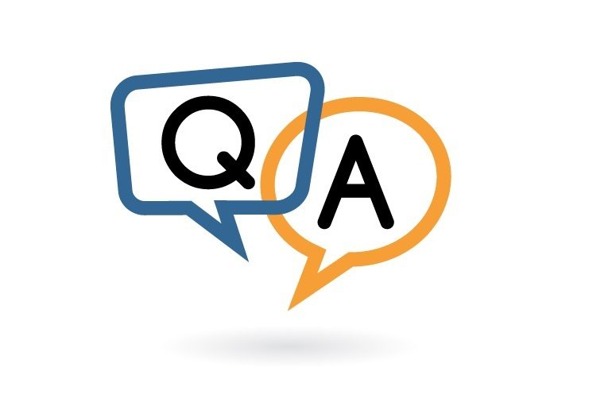
Thank You.

