Slide 1



2-Way
SMS

Slide 2



2-WAY SMS: Where conversations flow both ways
Ready to amplify your customer's voice and spark their engagement?
What are 2-way SMS?
No app? No net? No problem! Chat via 2-way SMS.
A cost-effective "we care" gesture.
A message from us = A moment for them.
Loyal to the brand? It starts with a beep.

Slide 3



2-WAY SMS: Where conversations flow both ways
Flip the Script on Chatting:
Buzz online & catch lightning-fast replies.
Seamless follow-through on every response.
Know who's in the loop - track responses on-the-fly.
Real feedback. Real results. Supercharge
your marketing strategy & Boost those ROI numbers!

Slide 4



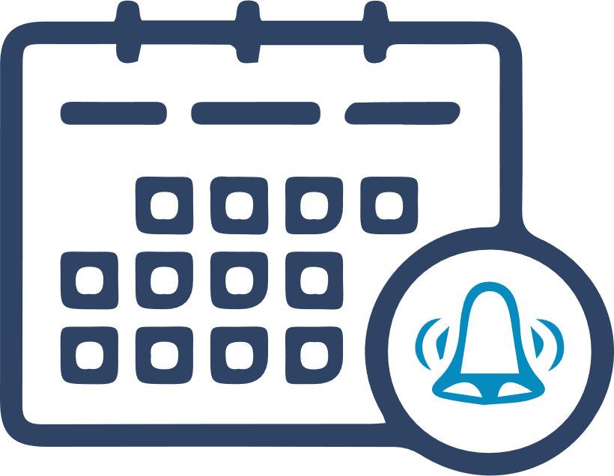


Elevate with 2-way SMS: conversational marketing magic
1-Reminders
Examples:
Alerts/ Reminders & Confirmations:
Event Reminders
Subscription Renewals
Bill

Slide 5
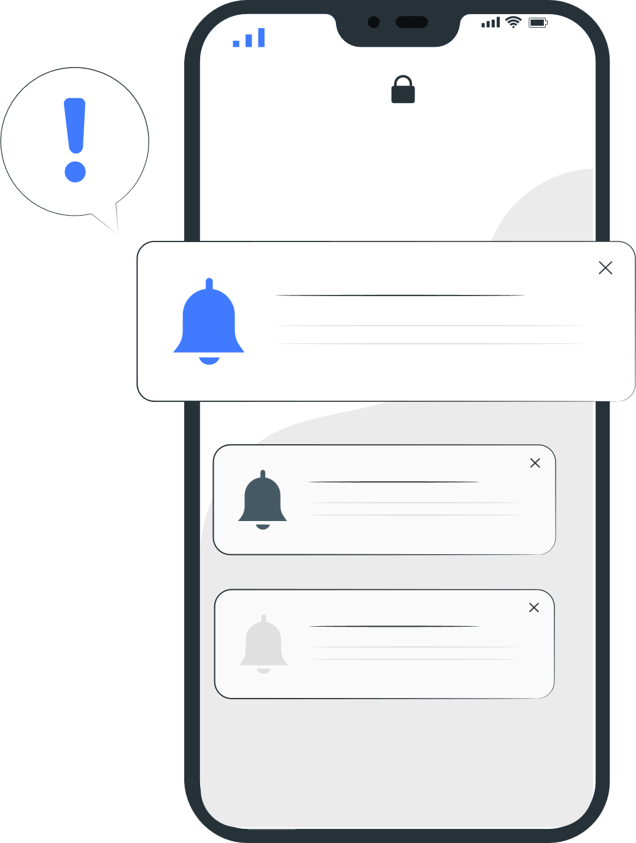




2-Notifications and alert
Examples:
Courier Companies:
Insurance Sector & Banks:
Order Status.
Delivery confirmation.
Loan application (it is being processed now).
Transaction Verification.
Self-service payment.
Payment reminders.
Missed payment alerts.
Electronic billing enrollment.
Payment authorizations/confirmations.
Stock quotes:
Bid and ask price.
Last-traded price.
Volume traded.

Slide 6

3-Survey:
Examples:
Run surveys: Want feedback on your
latest customer’s spa visit?

Slide 7

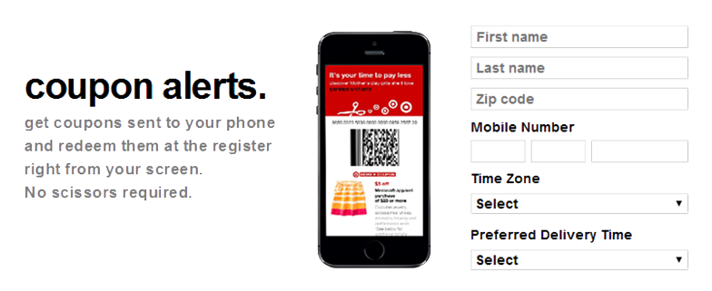
4-Promotion:
Examples:
Special offers, Coupons, Loyalty Programs….
Mobile coupon
Ride sweepstakes
Lottery
Trivia quizzes or fun competitions with grand prizes

Slide 8

5-Customer care:
Examples:
Complaint Submission: Products, support request etc…
Start a poll (Customer feedback): Hear It from Your Audience
Opt-outs: Stop commands - automatic unsubscribe:
(STOP, END, CANCEL, UNSUBSCRIBE or QUIT)
Autoresponder: Non-Stop SMS Engagement: Around the Clock

Slide 9
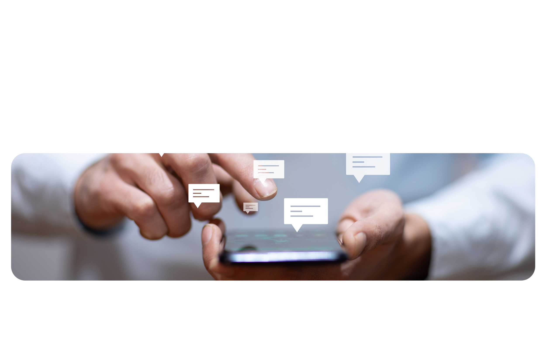
6-Renewal of services:
Such as: Voting, Membership Renewals, Annual Subscriptions and much more

Slide 10



PROCESS
Short code
Or Mobile Number sim card
Setup done by 1 week maximum, we provide you a mobile number to activate this solution.
Replies can be forward by email, sms or database integration. (No charge on replies)
Statistic Report: Customizable (Depend on your request)
Available REPORT:
Total number of SMS by delivered or rejected.
Total number of people clicking on 1 from the total delivered SMS.
Total number of people clicking on 2 from the total delivered SMS Phone numbers for each category.

Slide 11
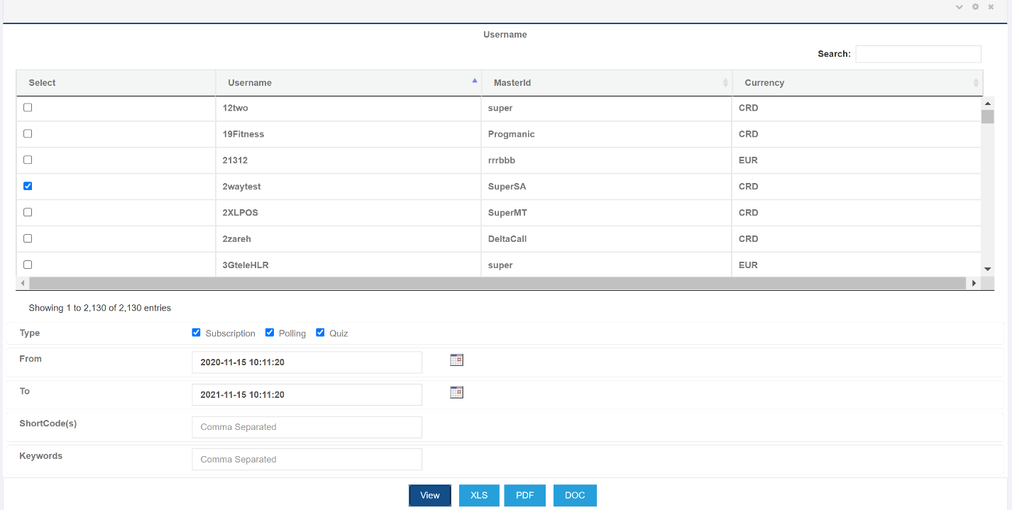
Report Samples:

Slide 12
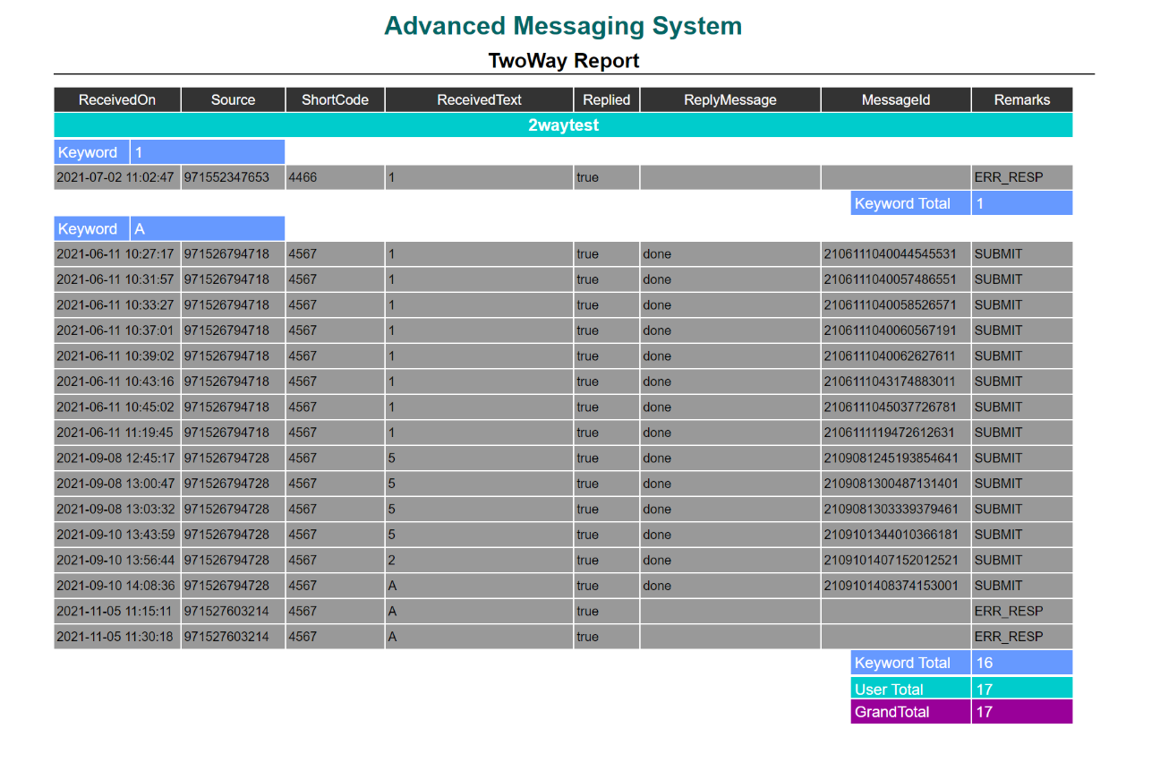

Slide 13




Ready to collaborate? Hit us up!
Lebanon | UAE | UK | Italy | Malta | India | Egypt | KSA | Australia | Jordan | USA | Bahrain | Qatar | Oman | Singapore | Nigeria | Turkey

