Slide 1




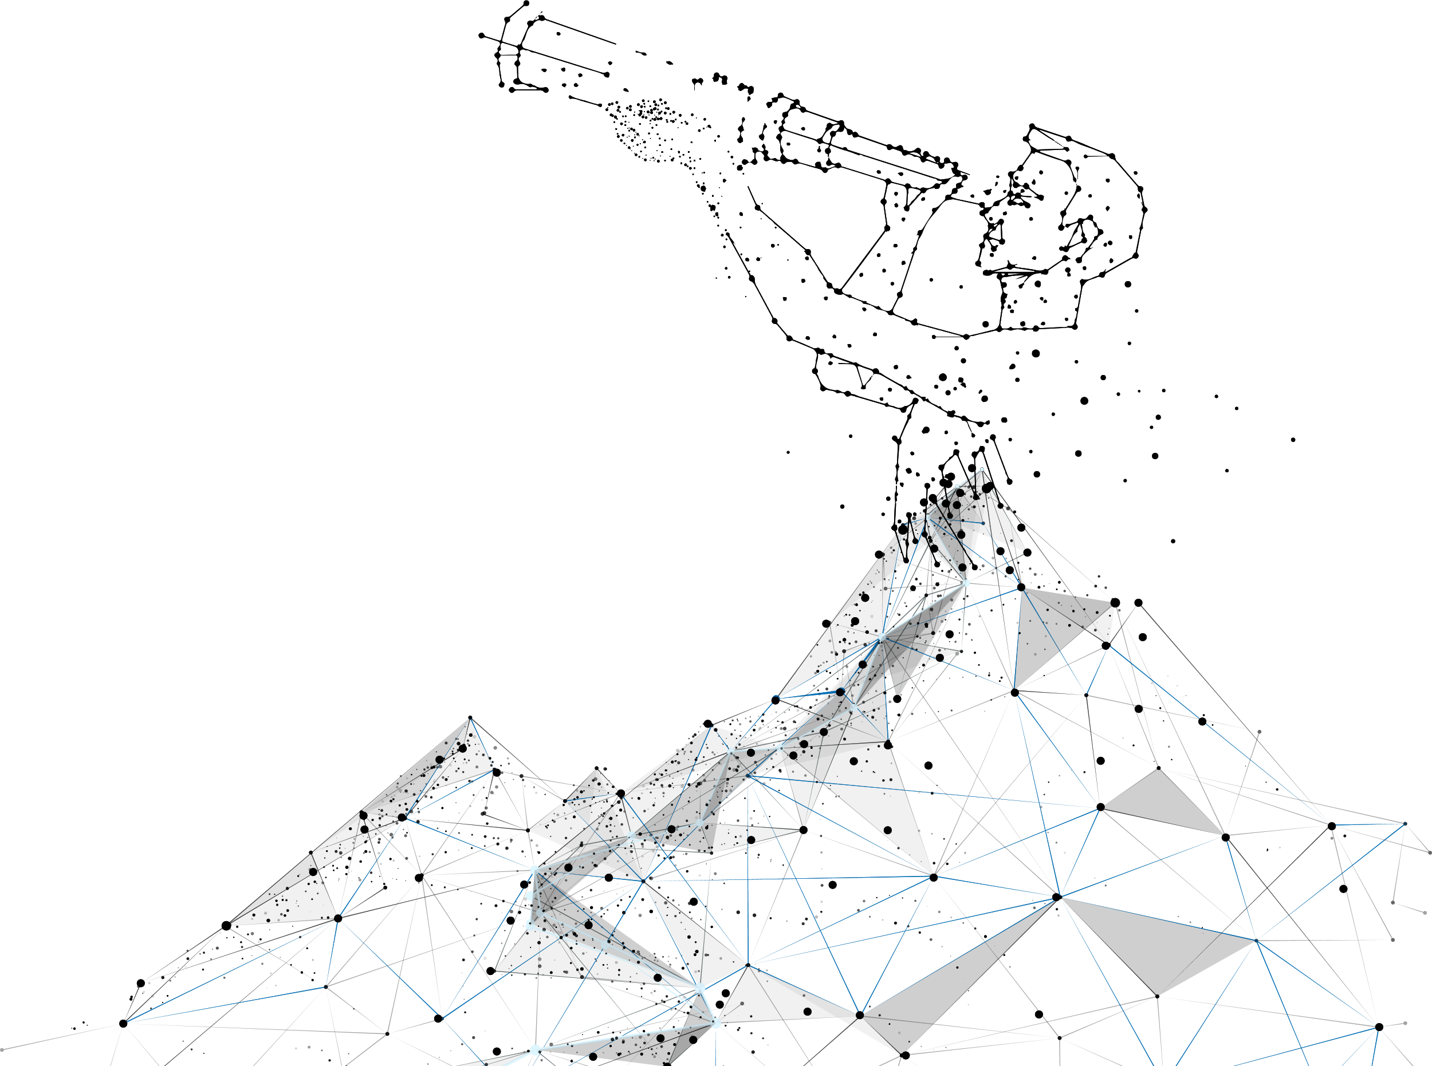

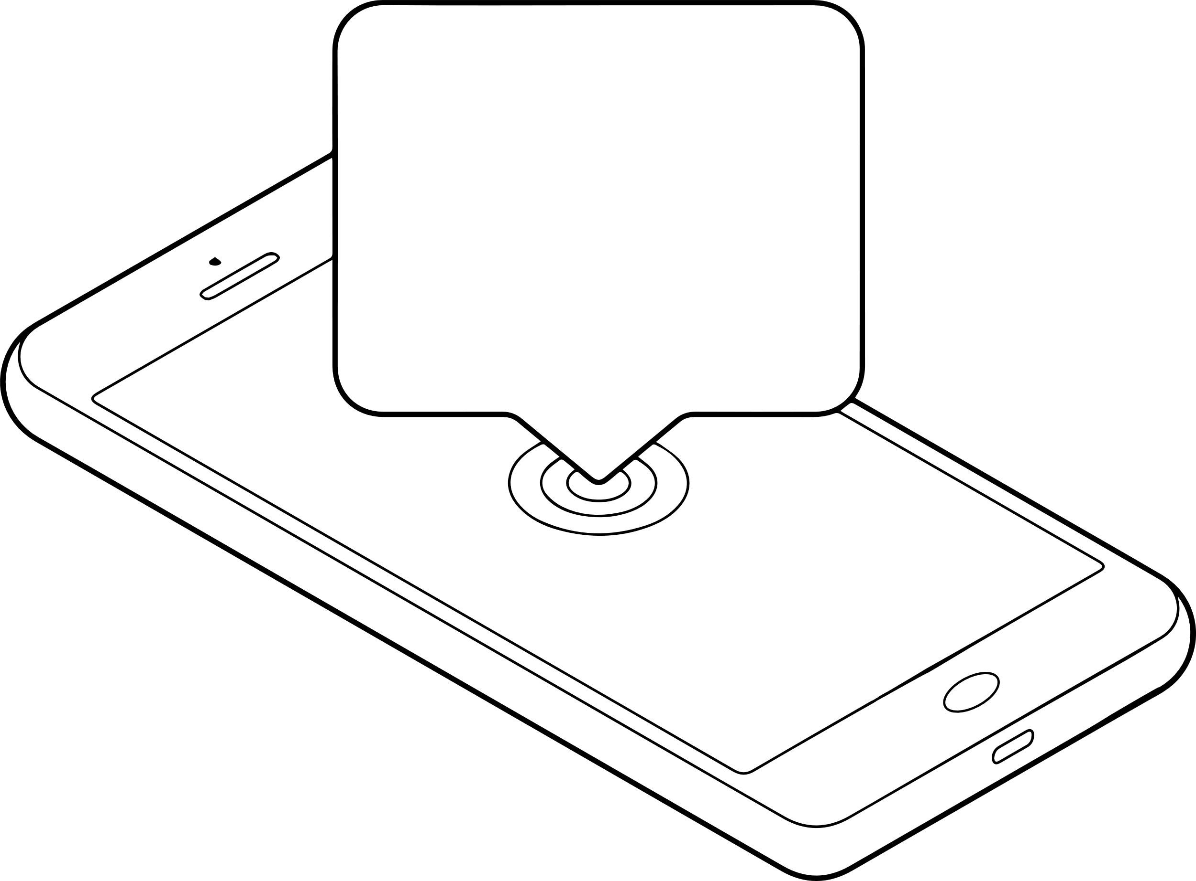

OUR SMS Marketing Experts are ready to provide you a
FREE Personalized consultation!
YEARS OF SMS Experience

Slide 2

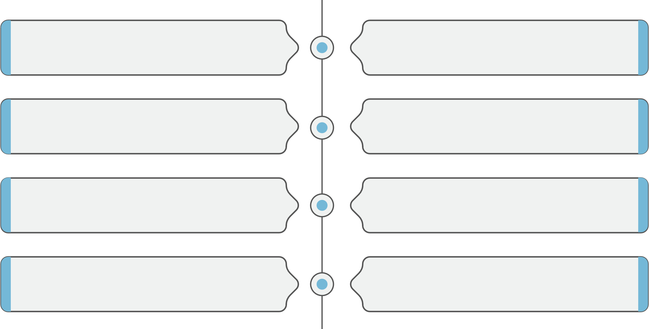
Do you want to create and implement a successful
SMS Marketing campaign?
Our SMS Marketing consultants have put a list of steps to help you make dramatic improvements in your business:
How to Write a clear & attractive Message
How to Measure & Track your campaign
How to Use Broadnet messaging features
How to Use our SMS Platform online
How to Get your Timing Right
How to Get the benefits of SMS Integration
How to Select your specific Target
How to reach the global market

Slide 3


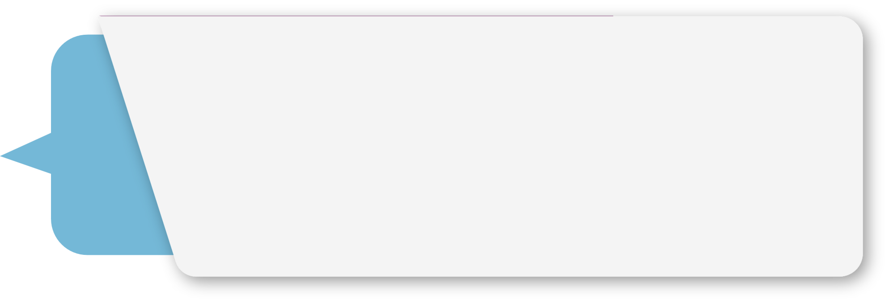

Case Study
Challenge
Write a Business Case Study according to
Market Research, Competitive advantages...
Solution
This Plan will include:
I. SMS Samples.
2. Adding attractive Features.
3. SMS process Suggestion by Target, Quantity, Time..
Result
Create Brand awarness, Increase Sales,
increase number of new clients

Slide 4

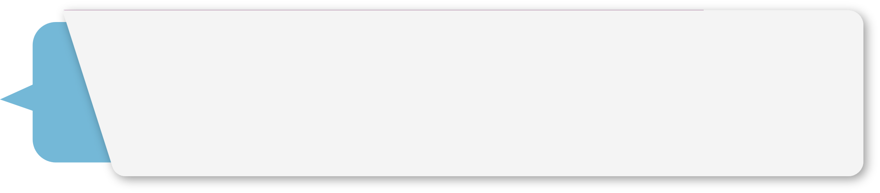

Company Background
Location:
Company Name:
Business Field:
Company Location:
Company Head Office Location:
Main Branches Locations:
International Branches Locations:
Do you use SMS? No…… Yes……
If yes mention the time of sending:
Weekly…… Monthly…… Yearly…… Occasionally…… Rarely……
Do you have Database: No…… Yes……
Do you use: Own database …… Targeted Database ……
Date of Campaign: ………… Budget: $ …………

Slide 5

Strategy
SMS Samples:
This is our Suggestion for You local/international:
Date
Time
Target
Quantity
Any New added value idea:

Slide 6
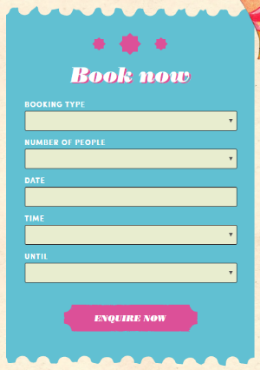
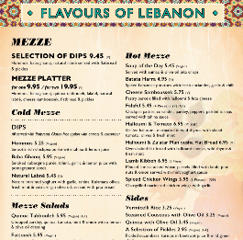


What you have
What we offer
Book Now
To send SMS to confirm the reservation
Menu
To Send the menu as a flipping page via link in SMS.
For example: Comptoir libanais has a special breakfast, check our menu: https://goo.gl/H3ezkt
Recipes & Tips
Since you have a database by gender you can share it with the Female who is interested in this recipes via SMS.
Delivery
Send Tracking delivery message:
1st: Once order is done
2nd: once order is on the way
3rd: Once order is received
4th: Feedback SMS (Do you like “Yes” or “No”

Slide 7

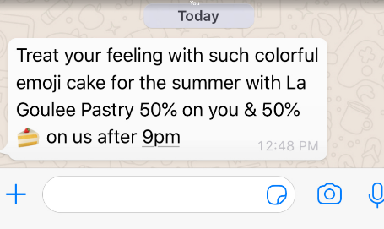
Strategy
Added Value:
***Do integration via our API where you can send SMS through your software for example:
“Thank you for your visiting us”
“Birthday Message, 10% Discount…”
Add our SMS Features:
Emoji
Survey message:
survey for competition/contest/prize, that can be an added value for
you to get a new contact who are interested in your product: https://www.broadnet.me/products/bulk-sms/
For any submission in this survey you will receive an email with the requested details.

Slide 8

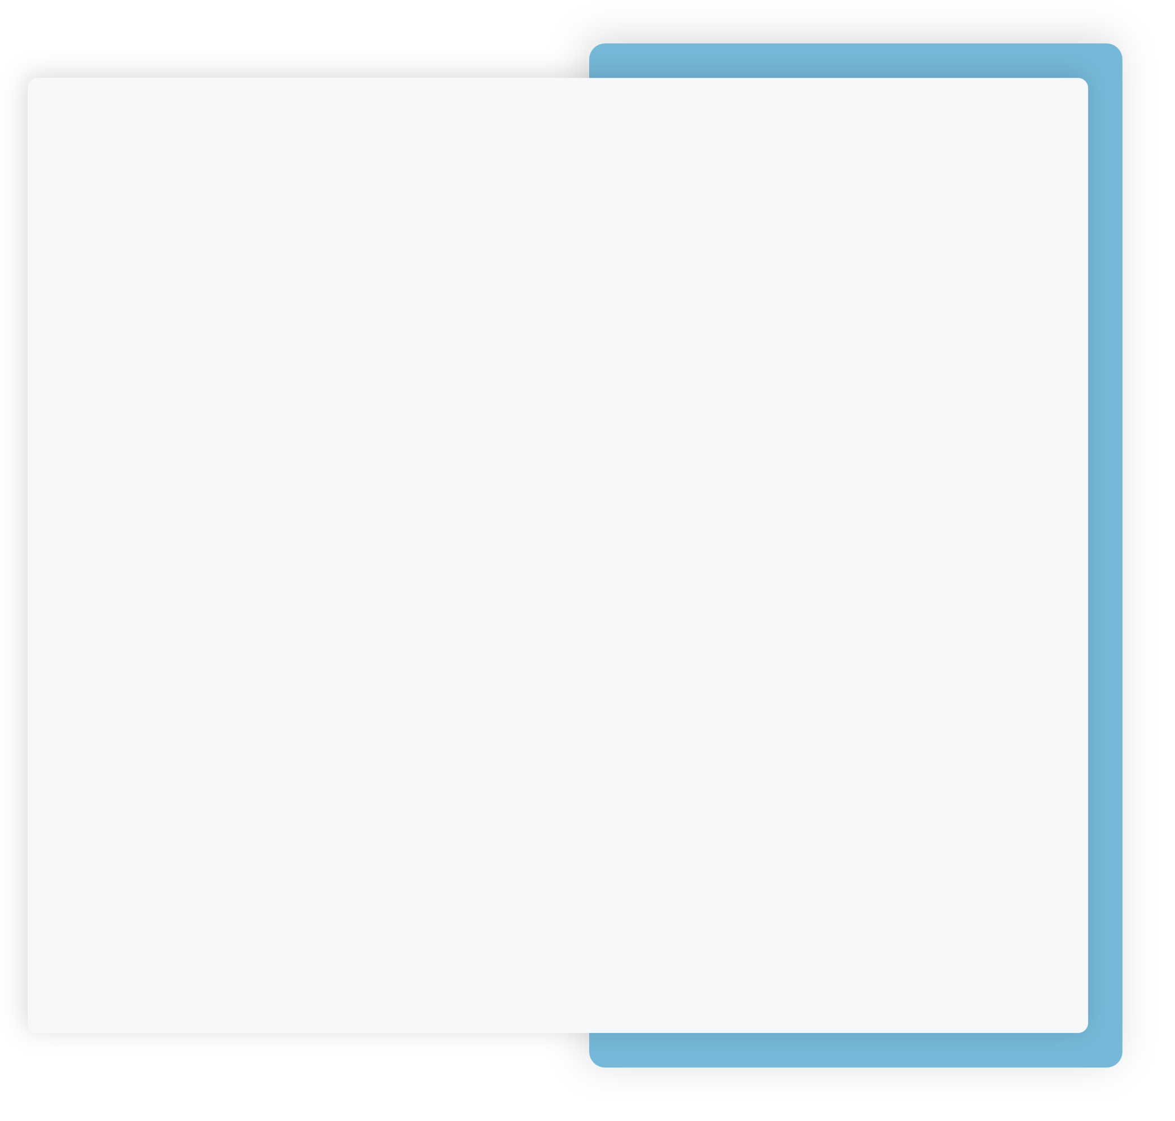
That’s Why You Have To Believe In Us
Strategy
Have 5 Data Center all over the world
Back Up Solution
24/7 Support (via skype, mobile and ticketing system)
Developer Team are always available for any request
More than 90 skilled Employees
System build in house
Any features can be customized and added
in our platform
Targeted Mass SMS Campaigns in more than 10 countries
Direct connection to more than 1000 operators
& carriers across the globe
20 Years in the Market
Expert in Messaging Solution
14 Offices worldwide
Membership in GSMA which has 800 operator’s members globally and around 300 companies. It organizes the MWC which is the “Largest exhibition in mobile industry in Barcelona”
ISO Certified Company in Data Security & Quality Management
GDPR for delivering quality & security of SMS Solutions that meet the requirements and expectations of today’s clients

Slide 9




Lebanon | UAE | UK | Italy | Malta | India | Egypt | KSA | Australia | Jordan | USA | Bahrain | Qatar | Oman | Singapore | Nigeria | Turkey

