Slide 2
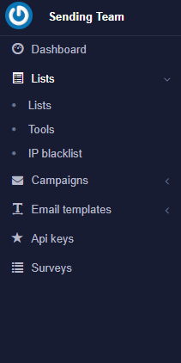
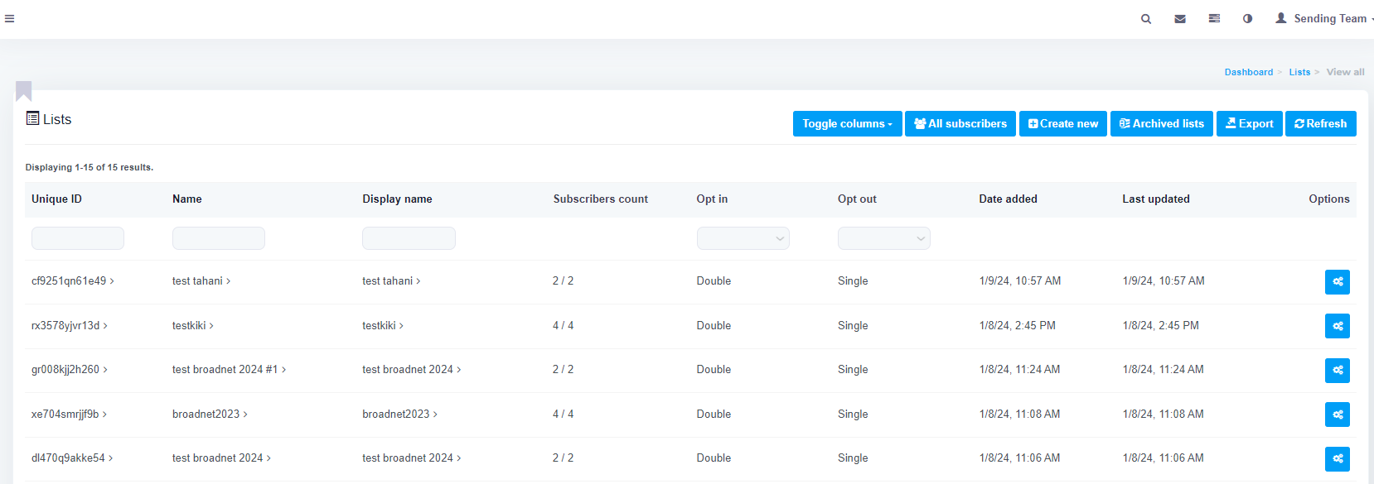
EMAIL CAMPAIGN
1- Click on menu (lists)
2- Press on Create New

Slide 3
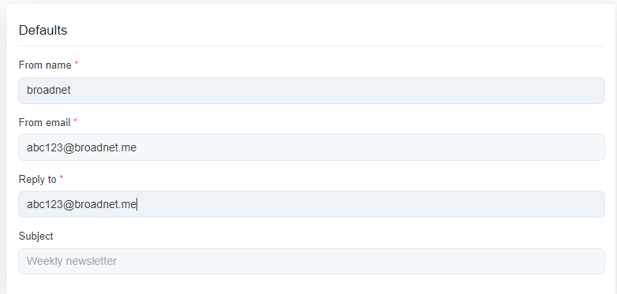
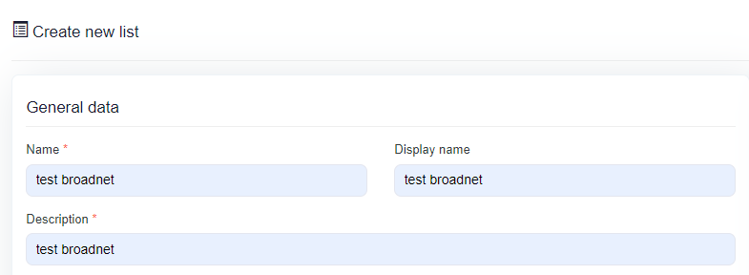
3-Fill blanks with General data
Name
Display Name
Description
4- Defaults
Fill only
From Name ex:Broadnet
From Email
Reply to

Slide 4
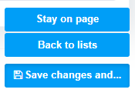
5- Company Details:
name
country
address
city
number
zip code
6- Press
Save changes
back to list

Slide 5
8- click on blue icon
7- A list appear including campaign name
ex: test broadnet
9- Press on import

Slide 6
10- Click on CSV
prepare the excel file in form of CSV

Slide 7
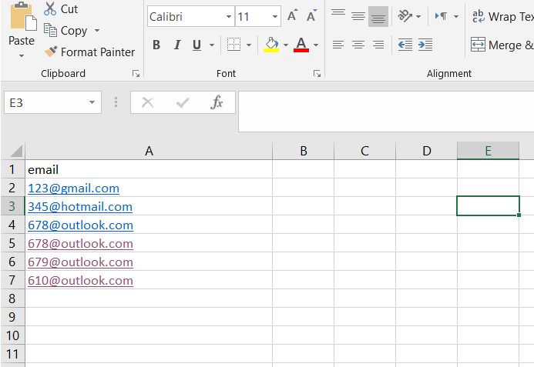
First enter to Excell
first row should be "email"
Insert email that should be tested
ex:

Slide 8
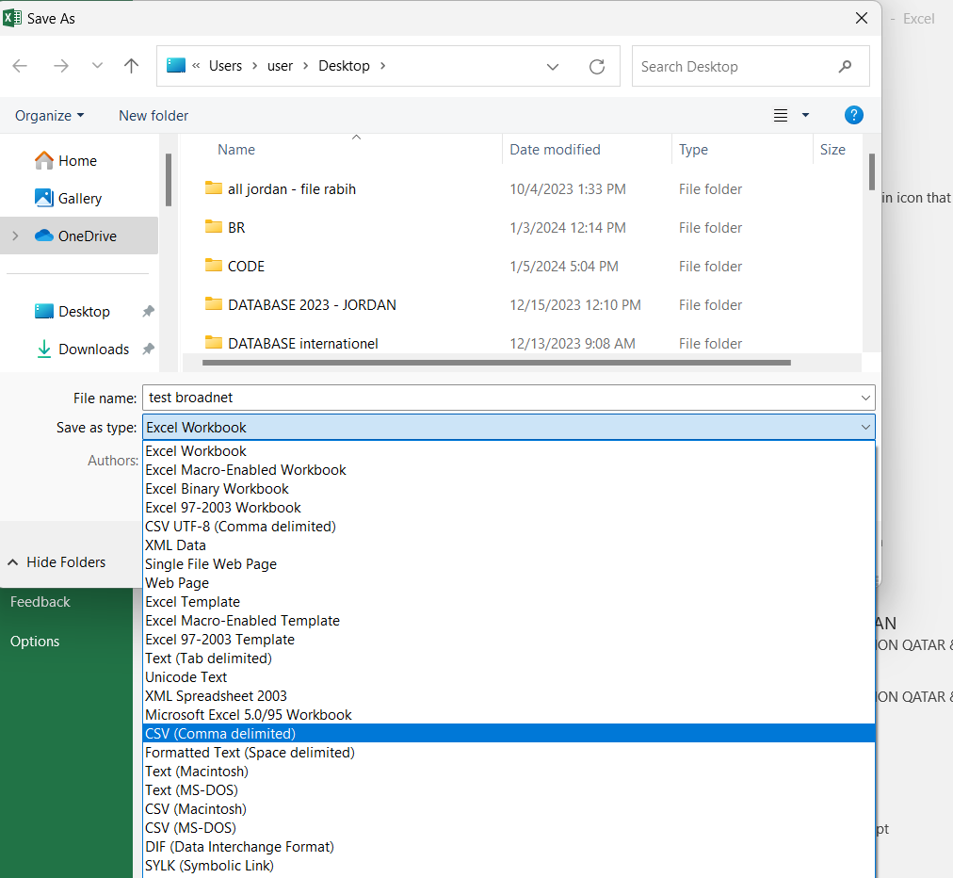
save as
file name: broadnet
save as type: csv (coma delimited)
Press save

Slide 9
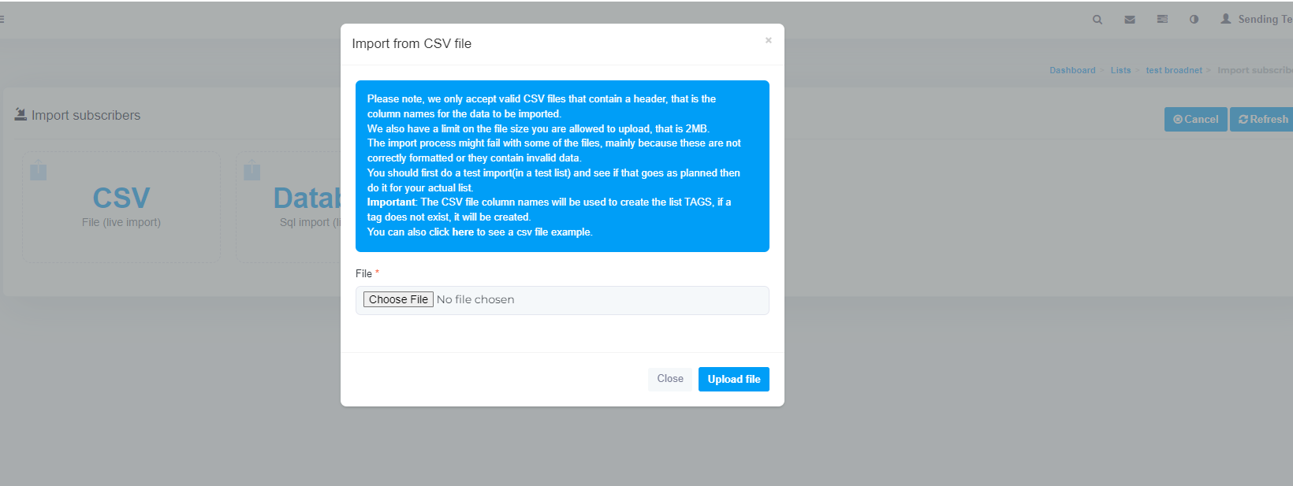
Choose
upload file

Slide 10
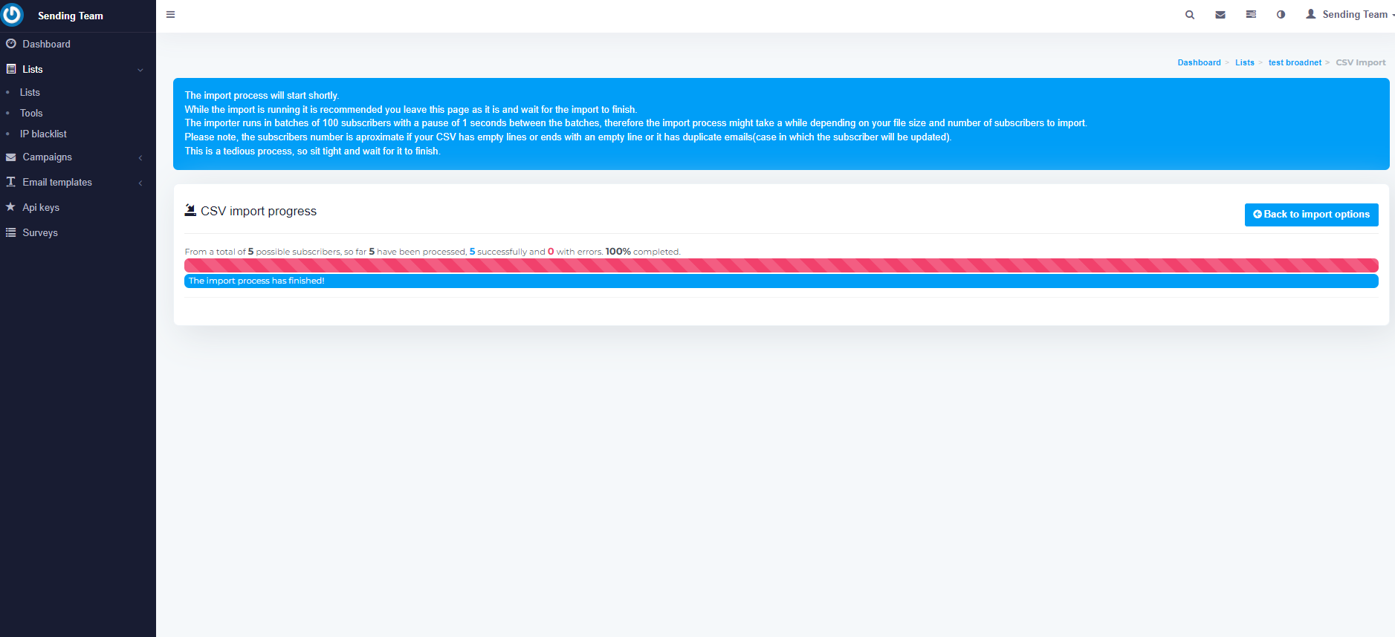
100% completed
the import process has finished

Slide 11
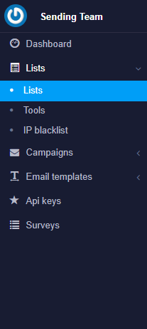
Press on
List
that show the quantity of emails

Slide 12
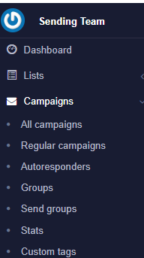
Click on
campaigns -regular campaign - create new

Slide 13
Fill in
campaign name
and
list
(the list name should be same as name
save and next

Slide 14
Fill the blank
from name
from email
reply to
subject
then
save and next

Slide 15
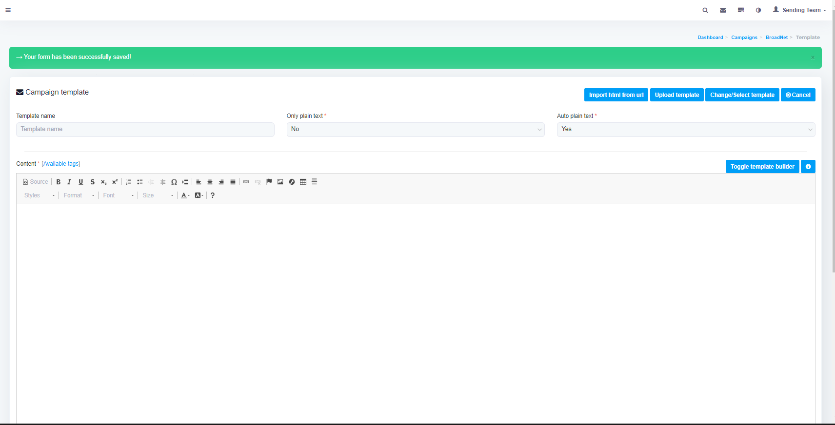
import picture

Slide 16
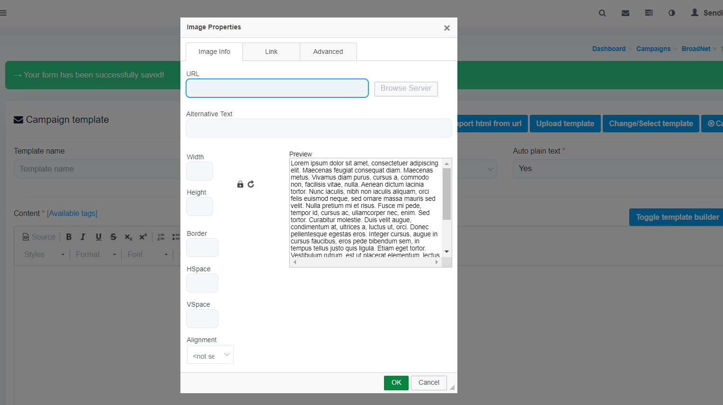
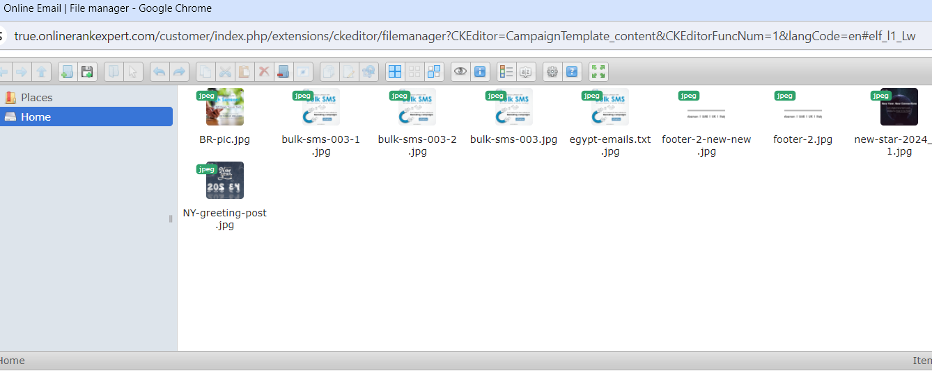
browse server
put the image

Slide 17
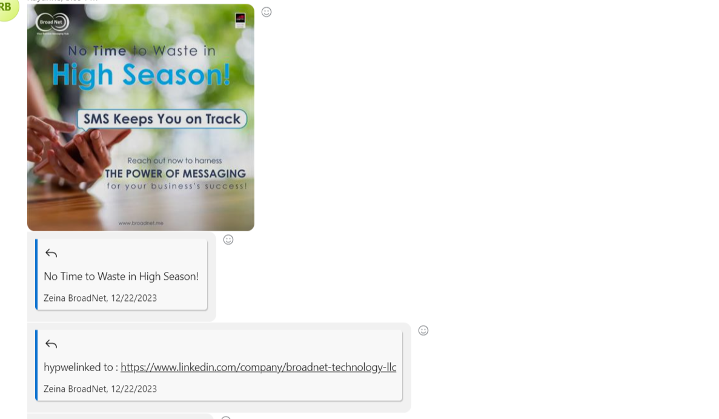
image
subject
link

Slide 18
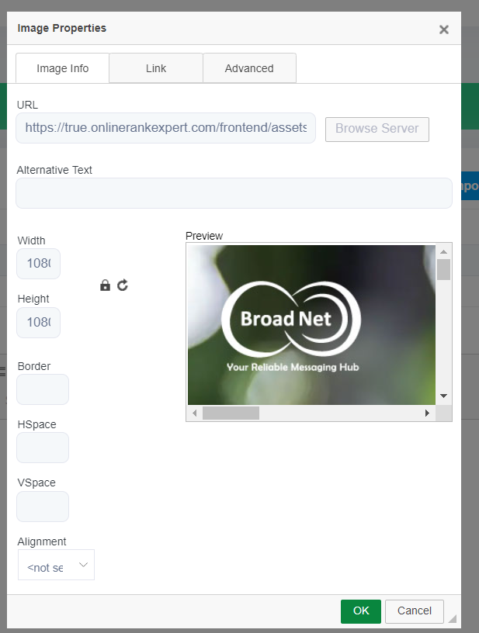
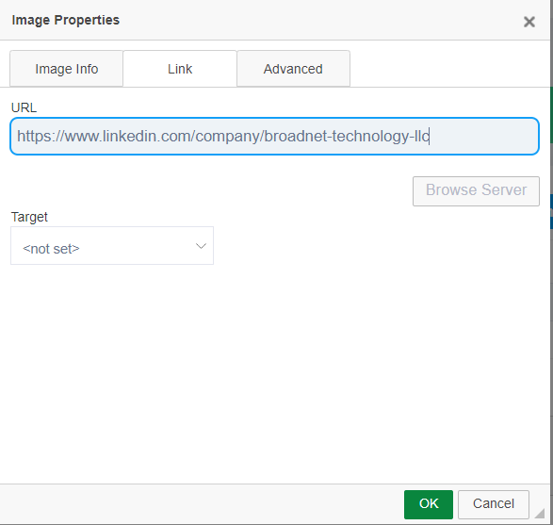
link

Slide 19
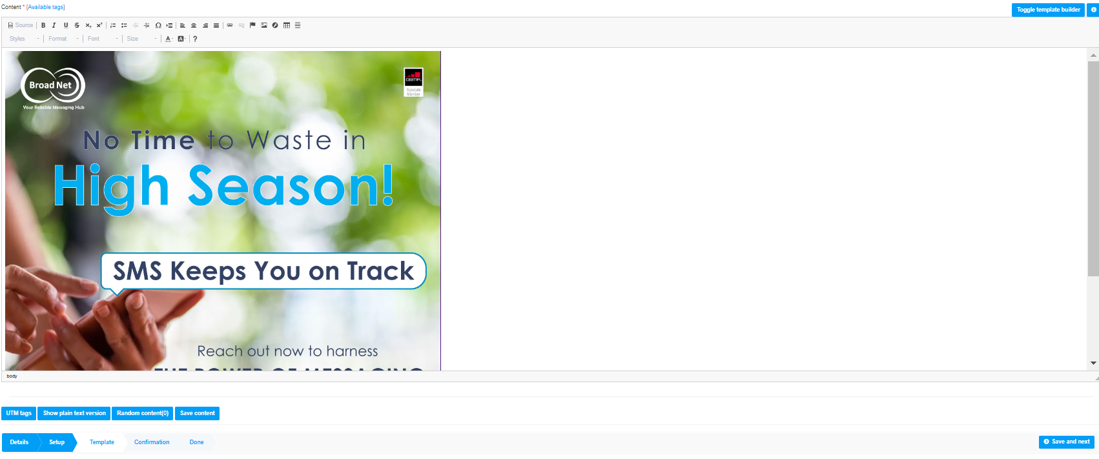
Press ok

Slide 20
press again
footer- browse server- image

Slide 21
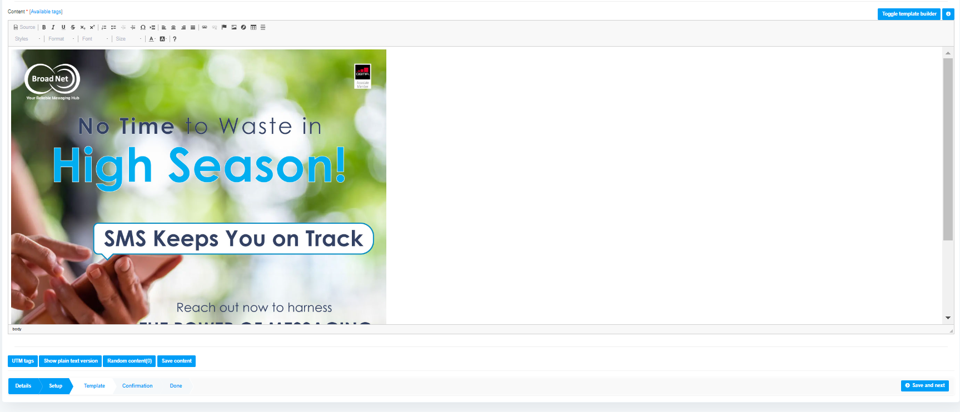
select available tags

Slide 22
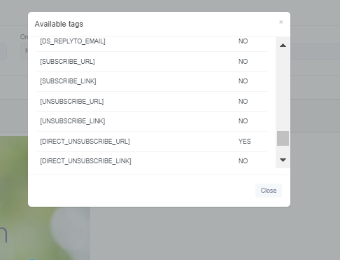
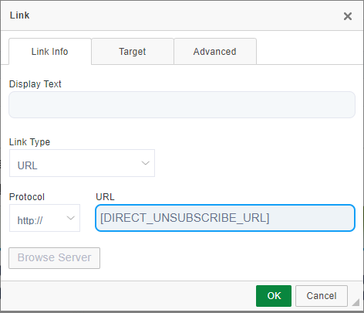
choose "yes"
select

Slide 23
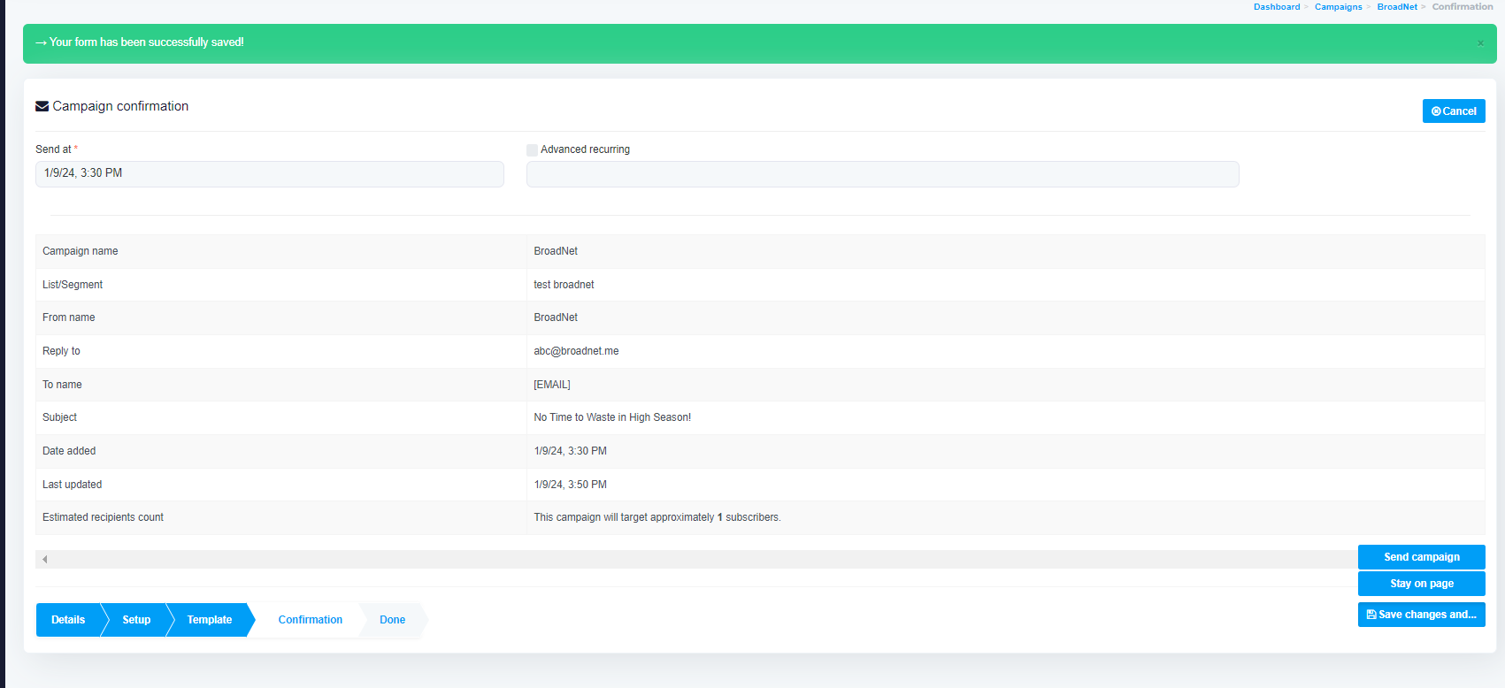
click on "save and next "
"send campaign "

Slide 25
Go to list
press on blue icon
copy
import
csv
Choose file
Regular campaign
copy
save and next
Save change and
send campaign

Slide 26
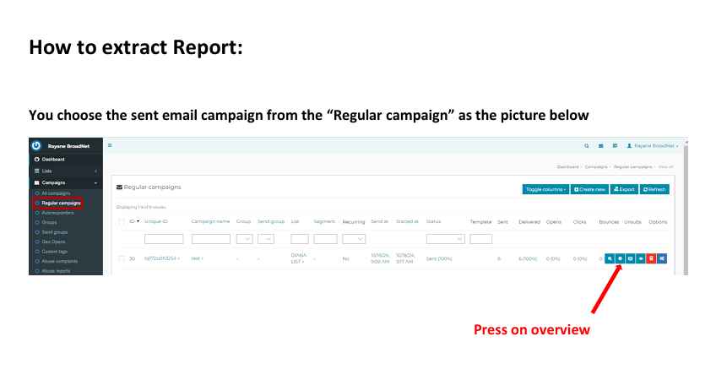

Slide 27
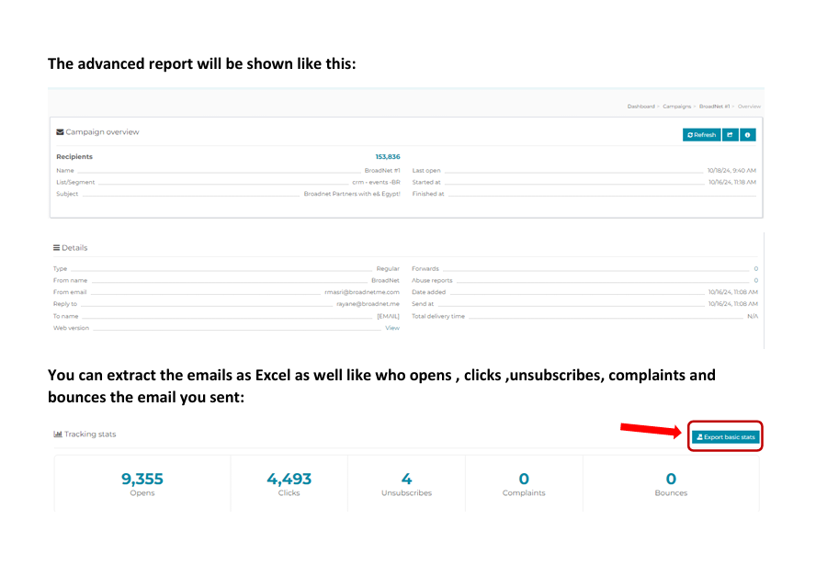

Slide 30
